Slide 1
Project: Feature Extraction and Price Prediction for Mobile Phones using Python
Project By :- Deepak Sharma
Project Description:- In this project, I worked with a dataset that contains detailed information about various mobile phones, including their model, color, memory, RAM, battery capacity, rear camera specifications, front camera specifications, presence of AI lens, mobile height, processor, and most importantly, the Price. My primary goal is to develop a predictive model for mobile phone prices.

Slide 2
Project Tasks
Data Exploration
Data Preprocessing
Feature Extraction
Model Building
Model Evaluation
Feature Importance Analysis
Dashboard Creation Using Tableau
Recommendations

Slide 3
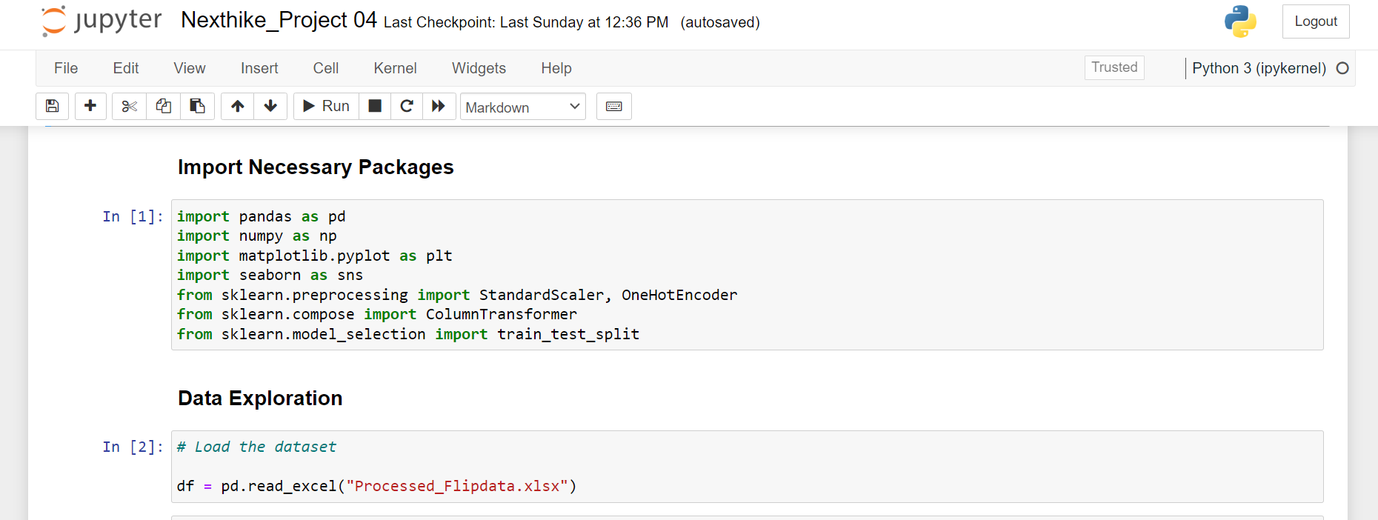
Data Exploration
Project started by loading and exploring the dataset to understand its structure, data types, the range of values for each feature etc.

Slide 4
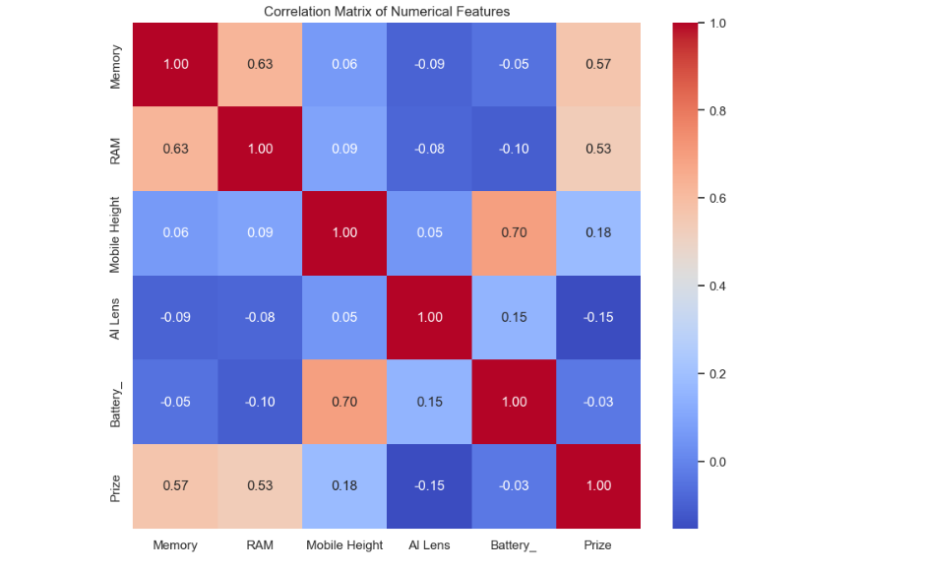
Correlation Matrix

Slide 5
Observations :- The heatmap above represents the correlation matrix among the numerical features of the smartphones in the dataset. Here are some key observations.
Memory and Prize: There is a moderate positive correlation between the memory of smartphones and it's prize. This suggests that as the internal storage increases, the prize of the smartphone tends to increase as well.
RAM and Prize: Similar to memory, There is also a moderate positive correlation between the RAM and prize. This indicates that smartphones with higher RAM are generally more expensive.
Battery capacity and Prize: The correlation between Battery capacity and Prize is relatively low, implying that the prize of smartphones doesn't increase significantly with larger battery capacity.
Mobile height and other features: The mobile height shows very low correlation with other features like memory, RAM, battery capacity and prize, indicating that the physical size of the phone is not strongly related to these specifications.
Memory and RAM: There is a significant positive correlation between memory and RAM. This makes sense as higher-end models often come with both higher RAM and memory.
AI lens Vs Prize : The correlation is very low, indicating that the presence of an AI lens feature does not significantly affect the prize

Slide 6
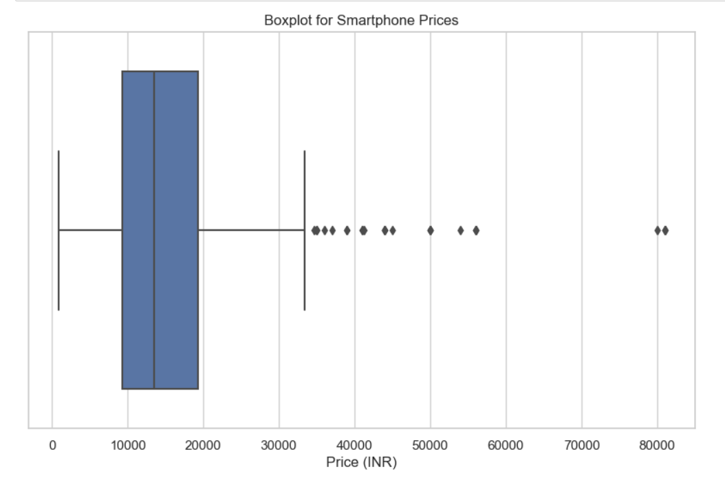
Plotting a boxlplot for the 'Prize' column to check for outliers

Slide 7
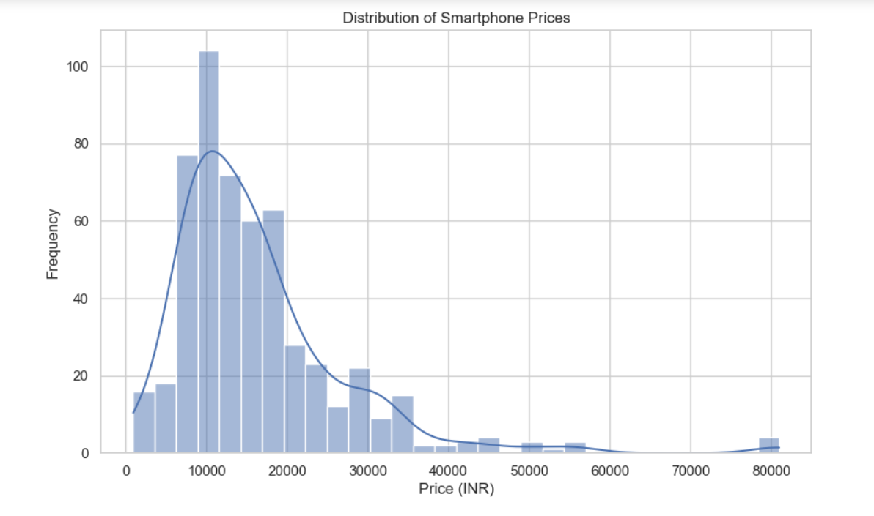
Some More Data Exploration By Visualization

Slide 8
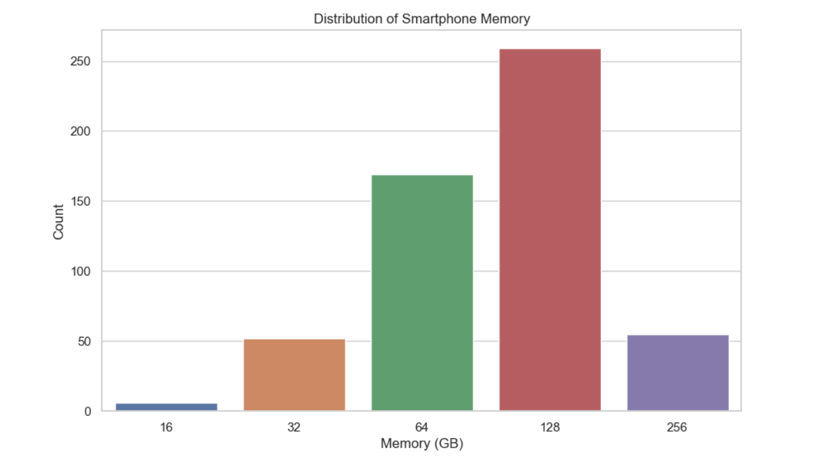

Slide 9
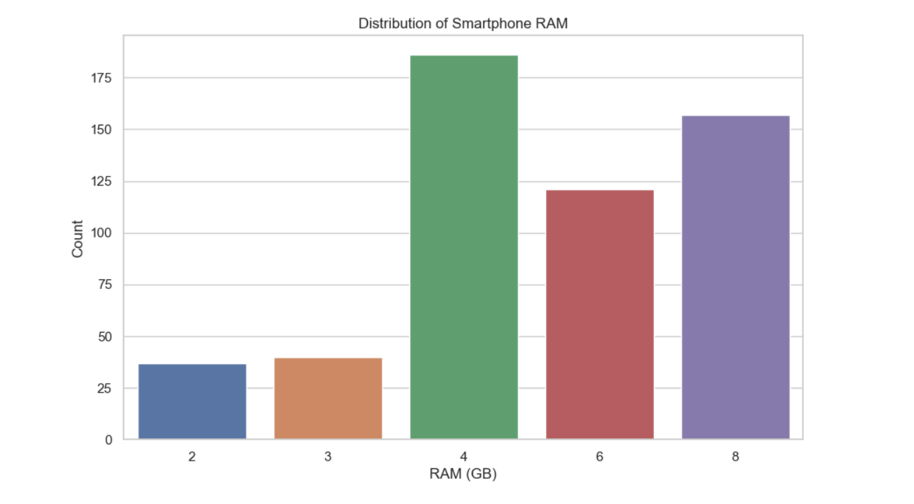

Slide 10
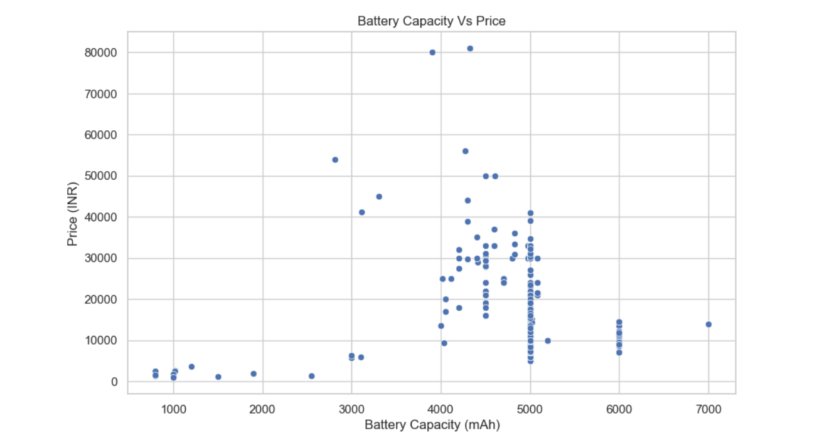

Slide 11
Observations :- Here are some more data exploration based on visualization.
Distribution of Phone Prices : The price distribution shows a wide range of prices, with a concentration of smartphones in the lower to mid price range, there are fewer smartphones in the higher price range, indicating a skew towards more affordable models.
Distribution of Phone Memory : The most common memory sizes are 128 GB and 64 GB, with fewer smartphones offering 256 GB, 32 GB and 16 GB. This suggests a preference in the market for smartphones with moderate to high storage capacity.
Distribution of Phone RAM : The distribution of RAM shows a significant number of smartphones with 4 GB and 8 GB RAM, followed by 6 GB. Fewer models have 2GB and 3GB RAM.
Battery Capacity Vs Price : The Scatter plot of Battery Capacity Vs Price doesn't show a strong linear relationship. This suggests that battery capacity is not a primary factor driving the price of the smartphones. High capacity batteries are available in both lower and higher priced models.

Slide 12
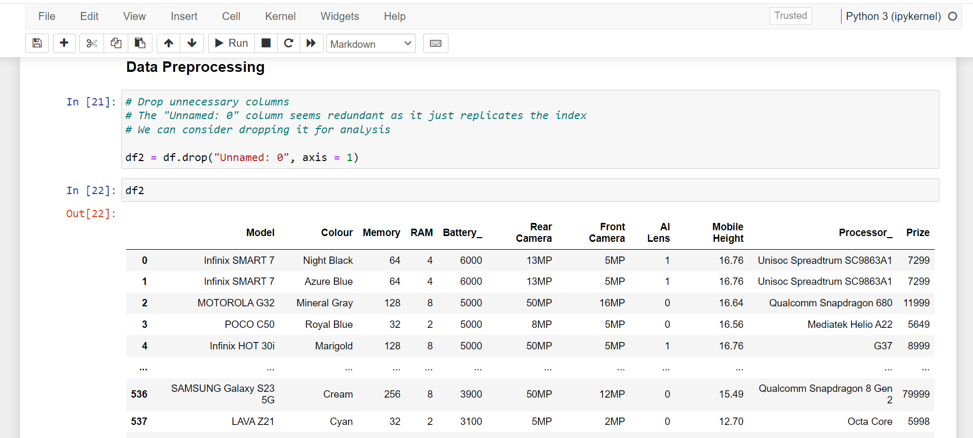
Data Preprocessing
Handled missing values, outliers and inconsistencies in the dataset. Converted categorical variables into a suitable numerical format, using One-hot encoding, Ordinal encoding and Label Encoding.

Slide 13
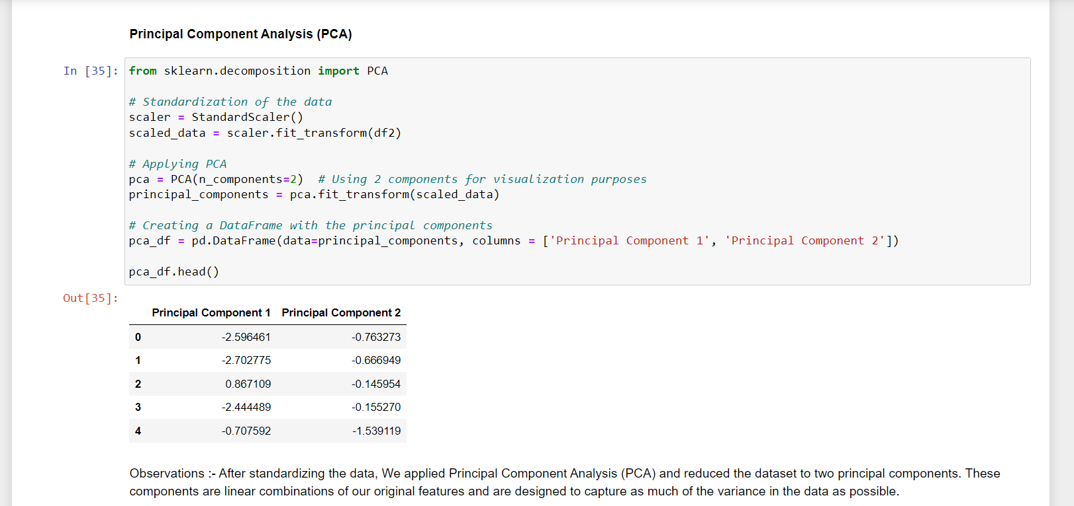
Feature Extraction
Performed feature extraction to identify the most relevant features that strongly affect the price of mobile phones with Principal Component Analysis (PCA).

Slide 14
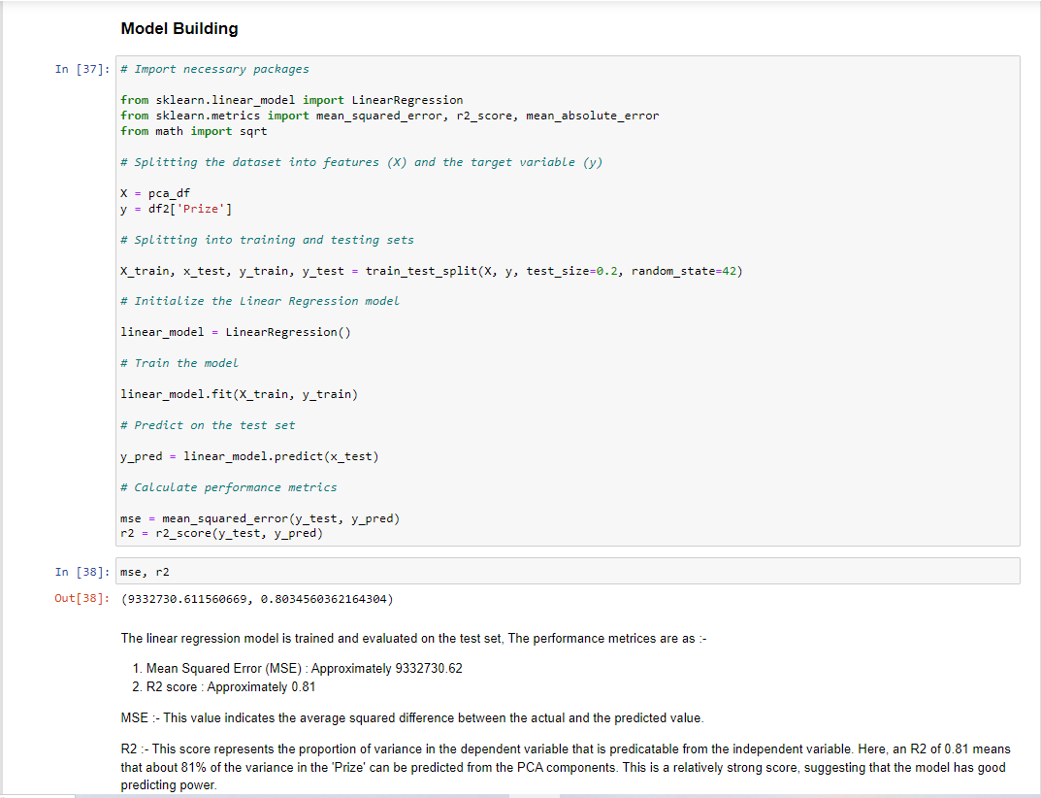
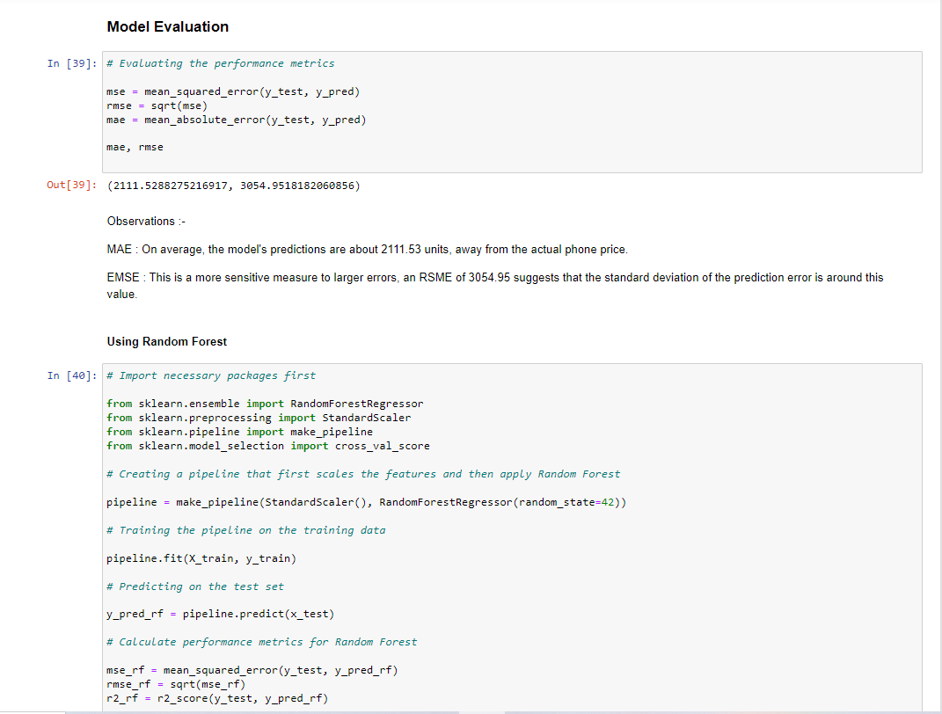
Model Building and Evaluation
The dataset has been splitted into training and testing sets and Developed a machine learning model for price prediction using various algorithms such as Linear Regression, Decision tree, Random forest and Gradient Boosting and evaluated the performance metrics such as mean absolute error, root mean squared error, R2 score.

Slide 15
Comparing metrics of different models
The linear regression model is trained and evaluated on the test set, The performance metrices are as :-
Mean Squared Error (MSE) : Approximately 9332730.62
R2 score : Approximately 0.81
MSE :- This value indicates the average squared difference between the actual and the predicted value.
R2 :- This score represents the proportion of variance in the dependent variable that is predicatable from the independent variable. Here, an R2 of 0.81 means that about 81% of the variance in the 'Prize' can be predicted from the PCA components. This is a relatively strong score, suggesting that the model has good predicting power.
The Random forest model is trained and evaluated on the test set, The performance metrices are as :-
Mean Squared Error (MSE) : Approximately 6635072.091
R2 score : Approximately 0.86
Observations :- Comparing these metrics to those from the Linear Regression Model, We notice improvements.

Slide 16
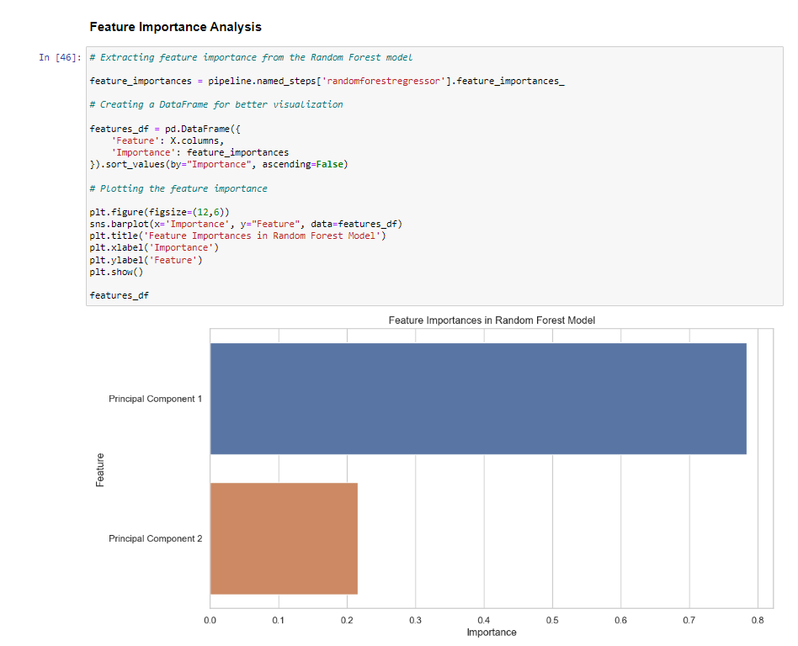
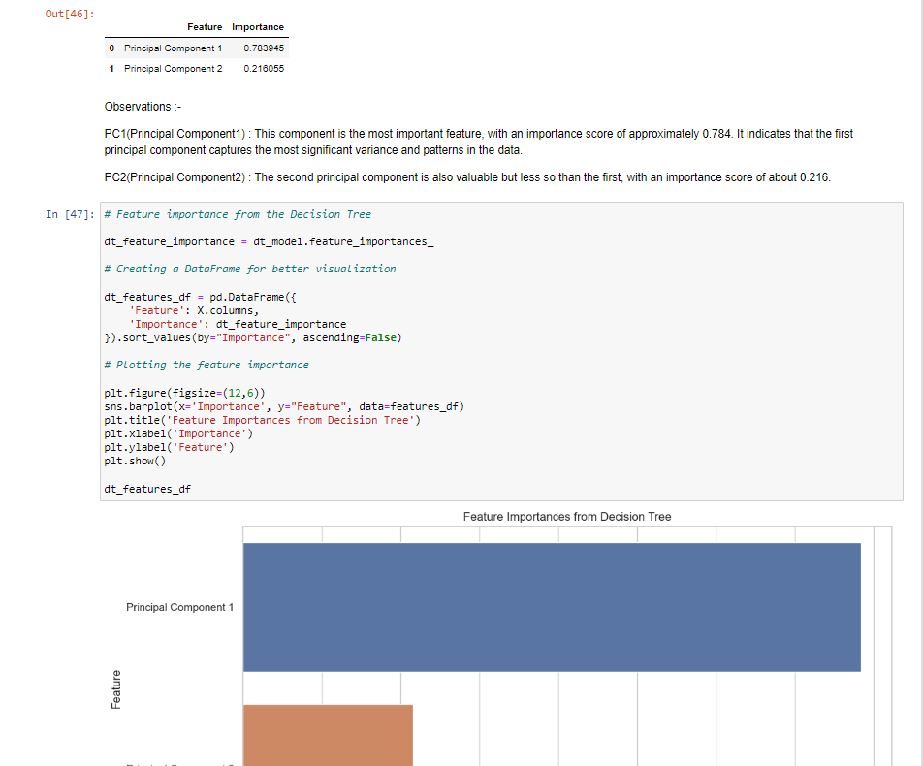
Feature Importance Analysis
Analyzed the feature importance obtained from the model to confirm the significance of the features identified during the feature extraction phase.

Slide 17
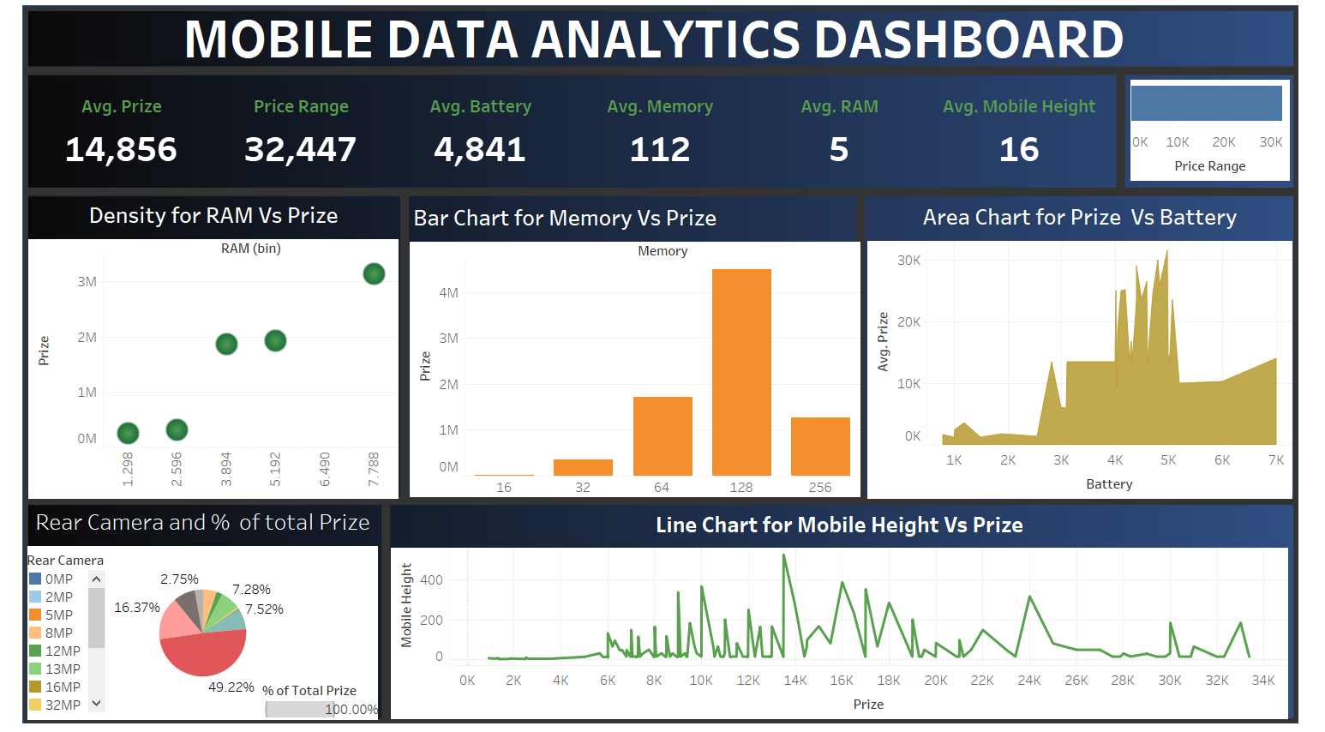
Dashboard Creation Using Tableau
Created a Dynamic Dashboard including multiple sheets with a minimum of 6-7 important data visualization charts to showcase the project requirement.

Slide 18





Python Libraries Used
Data science libraries such as NumPy, Pandas, Matplotlib, Seaborn and Machine learning libraries such as Scikit-learn (for Python) for building and evaluating the predictive model in the Jupyter Notebook Environment.

Slide 19
Project Conclusion
The model's reliance on PC1 more than PC2 aligns with the nature of PCA, where the first few components are designed to capture the most variance. Both the components are used (with significant weights) indicates that the feature extraction phase was successful in identifying meaningful patterns in the data. The dominance of PC1 suggests that most information relevant for predicting the mobile phone prices is encapsulated in this single component. However, with an average importance of approximately 0.21 (21 %), PC2 also plays a significant role in predictions.
Memory Size (RAM and Storage) : High positive loading in PC1. It means that Phone with more Memory and Storage tends to be priced higher and are important for performance-focused consumers.

Slide 20
Recommendations
Prioritize increasing Memory in higher-end models and highlight this in marketing to target performance-sensitive segments.
Recognize that different features will appeal to different segments. For instance, gamers might value processor speed and RAM, while travellers might look for battery life and durability.
Regularly assess how competitors are positioning their products concerning these key features. This can help in understanding market trends and customer expectations.
Engage with your customer base to get direct feedback on which feature they value most and how they perceive your offering.

